Slide 1
National Rural Employment Guarantee
S.Indujah
Data Analyst Intern
MIP-DA-09

Slide 2
CONTENT
Introduction
Dataset overview
Data cleaning & transformation
Dashboards
Insights
The end

Slide 3
INTRODUCTION
What is National Rural Employment Guarantee Act?
The National Rural Employment Guarantee Act (NREGA), now known as the Mahatma Gandhi National Rural Employment Guarantee Act (MGNREGA), is a social security measure enacted by the Indian government in 2005. Its primary objective is to enhance the livelihood security of people in rural areas by guaranteeing 100 days of wage employment in a financial year to every rural household whose adult members volunteer to do unskilled manual work.

Slide 4
Dataset overview
state_name: Name of the Indian state.
district_name: Name of the district within the state.
Total No. of JobCards issued: The total number of job cards issued to rural households.
Total No. of Workers: The total number of workers registered under NREGA.
Total No. of Active Job Cards: The number of active job cards at a given point in time.
Total No. of Active Workers: The number of workers currently engaged in NREGA works.
SC workers against active workers: The count of Scheduled Caste workers among active workers.
ST workers against active workers: The count of Scheduled Tribe workers among active workers.
Approved Labour Budget: The budget allocated for labor under NREGA.
Persondays of Central Liability so far: The total persondays of employment provided, considering central liability.
SC persondays: Persondays of employment provided to Scheduled Caste workers.
ST persondays: Persondays of employment provided to Scheduled Tribe workers.
Women Persondays: Persondays of employment provided to women.
Average days of employment provided per Household: The average number of days of employment provided per rural household.

Slide 5
Average Wage rate per day per person(Rs.): The average daily wage rate per NREGA worker in Indian Rupees.
Total No of HHs completed 100 Days of Wage Employment: The number of households completing 100 days of wage employment.
Total Households Worked: The total number of households involved in NREGA works.
Total Individuals Worked: The total number of individuals engaged in NREGA works.
Differently abled persons worked: The count of differently abled persons who participated in NREGA works.
Number of GPs with NIL exp: The number of Gram Panchayats with zero expenditure.
Total No. of Works Takenup (New+Spill Over): The total number of works initiated, including new projects and spill-over from previous periods.
Number of Ongoing Works: The count of works that are currently in progress.
Number of Completed Works: The count of works that have been successfully completed.
% of NRM Expenditure(Public + Individual): The percentage of expenditure on Natural Resource Management (NRM) projects, including both public and individual contributions.
% of Category B Works: The percentage of expenditure on Category B works.
% of Expenditure on Agriculture & Agriculture Allied Works: The percentage of expenditure on agriculture and allied activities.
Total Exp(Rs. in Lakhs.): Total expenditure in Indian Rupees (in lakhs).
Wages(Rs. In Lakhs): Expenditure on wages in Indian Rupees (in lakhs).
Material and skilled Wages(Rs. In Lakhs): Expenditure on materials and skilled wages in Indian Rupees (in lakhs).
Total Adm Expenditure (Rs. in Lakhs): Total administrative expenditure in Indian Rupees (in lakhs).

Slide 6
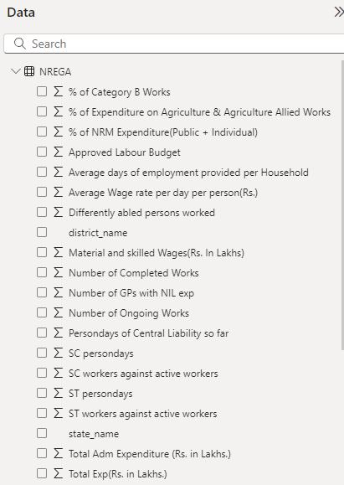
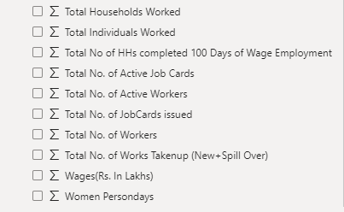
DATA CLEANING AND TRANSFORMATION

Slide 7
DASHBOARDS

Slide 8
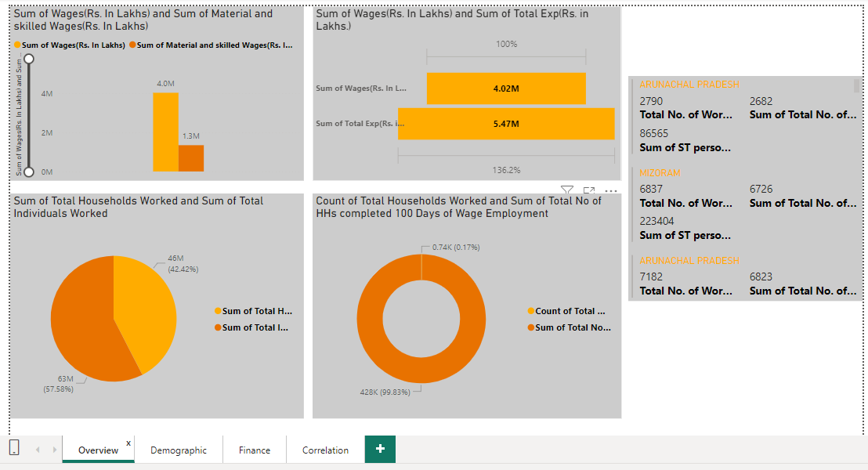
DASHBOARD 1-Overview Tab

Slide 9
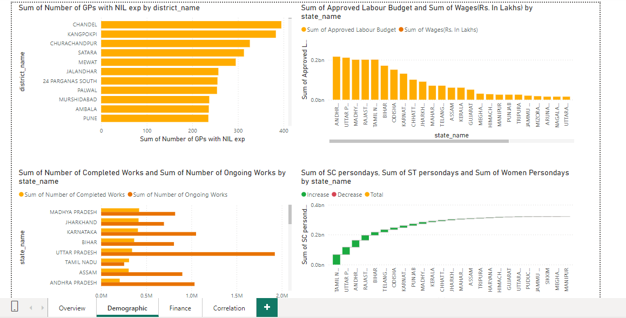
DASHBOARD 2-Demographic

Slide 10
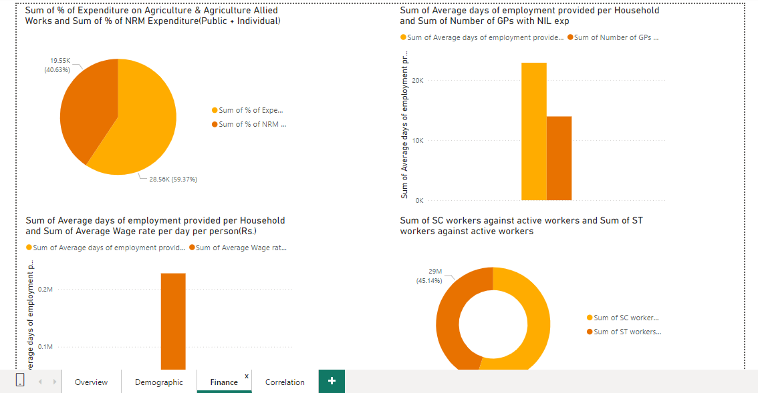
DASHBOARD 3 – Finance

Slide 11
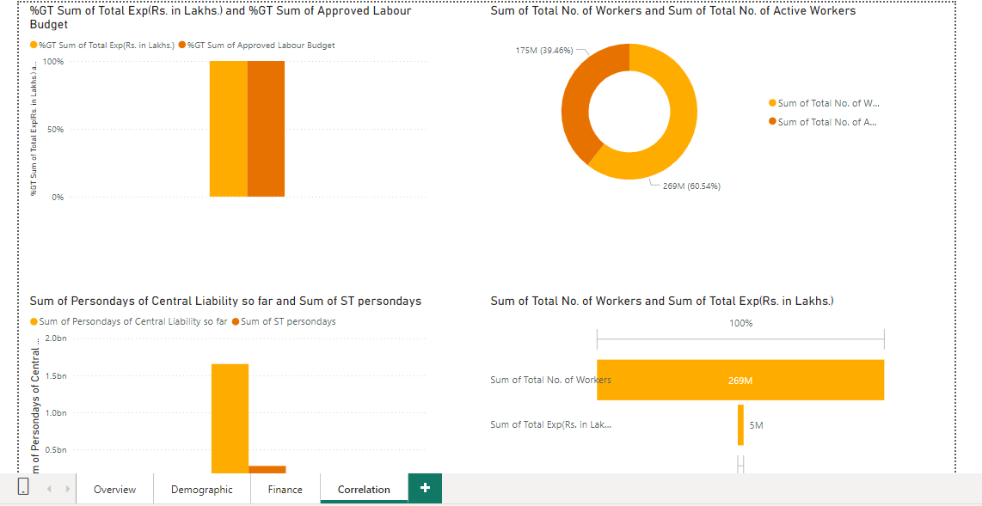
DASHBOARD 4 –Correlation

Slide 12
INSIGHTS

Slide 13
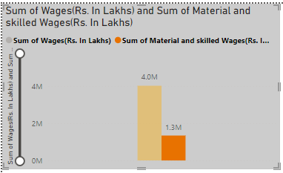
Figure 1 –Sum of wages and sum of material & skilled wages
In this comparison, between sum of wages & sum of material & skilled wages are 4.0 million and 1.3 million

Slide 14
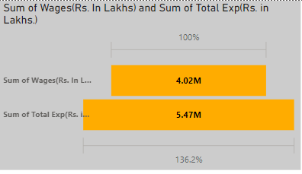
Figure 2 Sum of wages & sum of total exp (Rs.in laks)
In this comparison, between sum of wages & sum of total exp are 4.02 million and 5.47 million

Slide 15
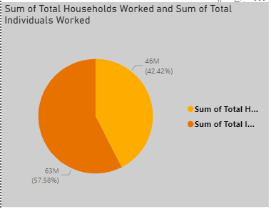
Figure 3 Sum of total households worked and sum of total individuals worked
In this comparison, between Sum of total households worked and sum of total individuals worked are 46 million and 63 million

Slide 16
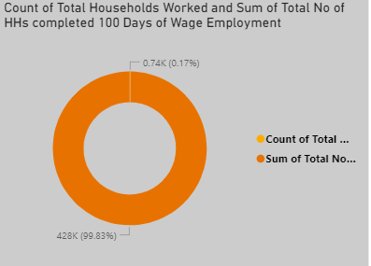
Figure 4 count of total households worked & sum of total no of HS completed 100 days of wage employment
In this comparison, between count of total households worked & sum of total no of HS completed 100 days of wage employment are 0.74K and 428K

Slide 17
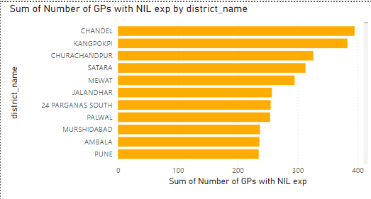
Figure 5 Sum of number of GPS with nill exp by district_name
In this comparison,you can see the various numbers between different district name & Sum of number of GPS with nill exp

Slide 18
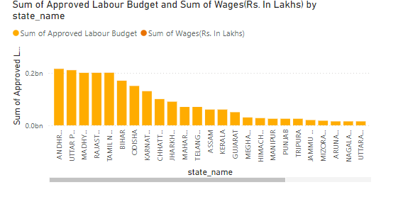
Figure 6 Sum of approved labour budget & sum of wages by state name
In this comparison,you can see the various numbers between sum of wages by state name & Sum of approved labour budget

Slide 19
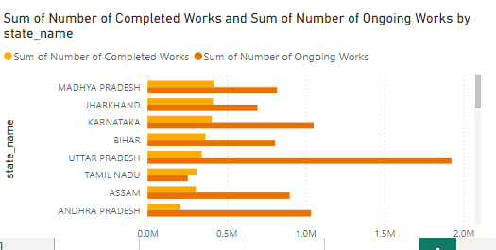
Figure 7 sum of number of completed works & sum of number of outgoing works by state_name
In this comparison, you can see the various numbers between sum of number of completed works & sum of number of outgoing works by state_name

Slide 20
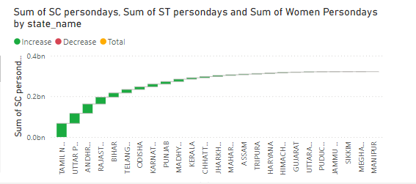
Figure 8 Sum of SC persondays.Sum of ST persondays and sum of women persondays by state_name
In this comparison, you can see the various numbers between Sum of SC persondays.Sum of ST persondays & sum of women persondays by state_name

Slide 21
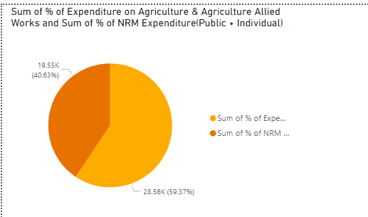
Figure 9 Sum of % expenditure on agriculture & agriculture allied works and sum of % of NRM expenditure(Public +individual)
In this comparison, between Sum of % expenditure on agriculture & agriculture allied works and sum of % of NRM expenditure(Public +individual) such as 19.55K and 28.56K

Slide 22
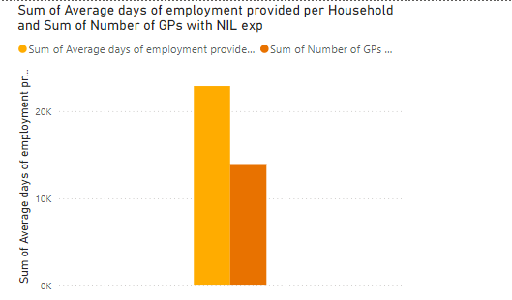
Figure 10 Sum of average days of employment provided per household & sum of number of GPS with nill exp
In this comparison, between Sum of average days of employment provided per household & sum of number of GPS with nill

Slide 23
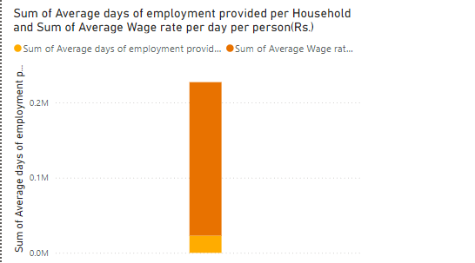
Figure 11 Sum of average days of employment provided per HS & sum of average wage rate per day per person
In this comparison, between Sum of average days of employment provided per HS & sum of average wage rate per day per person

Slide 24
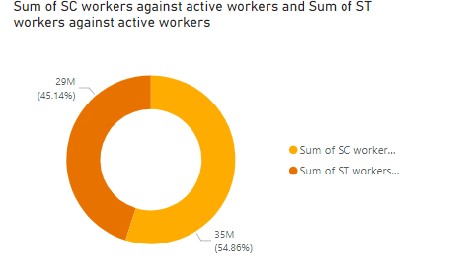
Figure 12 Sum of SC workers against active workers & sum of SLT workers against active workers
In this comparison, between Sum of SC workers against active workers & sum of SLT workers against active workers such as 29M and 35M

Slide 25
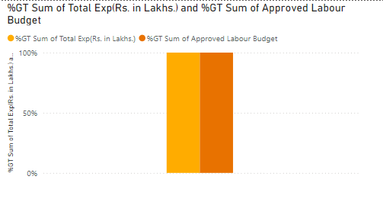
Figure 13 %GT sum of total exp & GT sum of approved labour budget
In this comparison, between %GT sum of total exp & GT sum of approved labour budget

Slide 26
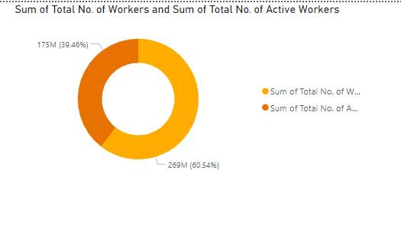
Figure 14 Sum of total no of workers & sum of total number of active workers
In this comparison, between Sum of total no of workers & sum of total number of active workers

Slide 27
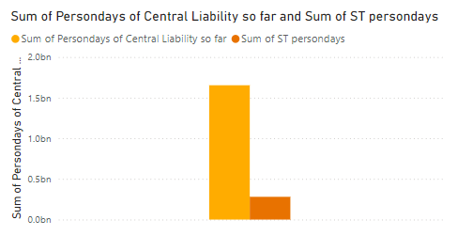
Figure 15 Sum of persondays of central liability so far & sum of ST persondays
In this comparison, between Sum of persondays of central liability so far & sum of ST persondays

Slide 28
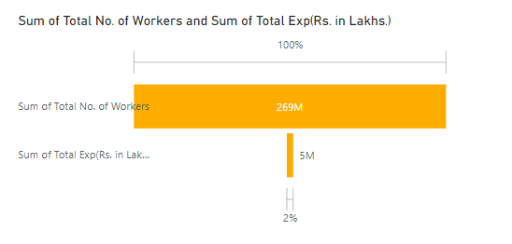
Figure 16 Sum of workers & sum of total exp
In this comparison, Sum of workers & sum of total exp
such as 269M and 5M

Slide 29
THANK YOU

